Slide 1
Academic credential verification using Blockchain
Submitted in the partial fulfillment for the award of the degree of
BACHELOR OF ENGINEERING
IN
Information Security
Submitted by:
Prakash Singh
20BCS3707
Under the Supervision of:
Shagun Rana(E12906)
Kushagra Agrawal(E13465)
Department of AIT-CSE
DISCOVER . LEARN . EMPOWER

Slide 2
Outline
Introduction to Project
Problem Formulation
Objectives of the work
Methodology used
Results and Outputs
Conclusion
Future Scope
References

Slide 3

Introduction to Project
Blockchain innovation is a rising innovation and offer highlights like decentralized, straightforward and sealed information stockpiling. It could be utilized to tackle issues for instance like absence of trust, misrepresentation, high exchange cost and sharing security Consequently, blockchain innovation may be a hopeful innovation to forestall the misrepresentation exercise in our present academic credential verification system which includes a lot of paperwork, forged degrees or degree from fake universities, delay admission processes and human error.

Slide 4






Features of Blockchain
Trustless
in blockchain every block of information is verified over a network and then added to the chain so you don’t have to trust a central authority
Decentralized Architecture
Unlike the present Architecture which follow a server- client approach in this data is stored in every node/Block .
Faster Settlement
Security
Transfer of money is vary fast due to no conversion rate and smart contracts are used for transfer of assets
Asymmetric cryptographic Algorithms are used to ensure secured communication between sender and receiver .
Integrity
It uses consensus algorithm which ensures that there is only one valid copy of the data that is shared by all nodes

Slide 5


“Academic credential verification using Blockchain” focuses on checking the authenticity and integrity of the academic credential that have been issued by the University in an optimal and efficient way. it allows the recruiters to verify the credentials of job applicant faster by removing the third party (University) and thus reducing the time delay and making the verification process much more efficient. This will lead to a smooth credential verification and solve the problem of fake academic credential in order to get a job or admission in a university.

Slide 6
Problem Formulation
Education acts as a soul in the overall societal development, in one way or the other. Aspirants, who gain their degrees genuinely, will help society with their knowledge and skills. But, on the other side of the coin, the problem of fake certificates is alarming and worrying. It has been prevalent in different forms from paper-based dummy certificates to replicas backed with database tampering and has increased to astronomic levels in this digital era.
The proposed system makes sure that the certificates, once verified, can be present online in an immutable form for further reference and provides a tamper-proof concealment to the existing certification system. To confirm the credibility of the proposed method, a prototype of blockchain-based credential securing and verification system is developed in ethereum test network. The implementation and test results show that it is a secure and feasible solution to online credential management system.

Slide 7
Objectives of the Work
The objective is to automate the process of verification of academic credential by exploiting the immutable property of blockchain. The proposed system focuses on checking the authenticity and integrity of the academic credential that have been issued by the University in an optimal and efficient way. it allows the recruiters to verify the credentials of job applicant faster by removing the third party (University) and thus reducing the time delay and making the verification process much more efficient. This will lead to a smooth credential verification and solve the problem of fake academic credential in order to get a job or admission in a university.

Slide 8


Methodology used
Choosing Blockchain based on the nature of the project In this case the project require storage of data for which proof of work consensus algorithm will be used hence Ethereum blockchain is chosen.
Building smart contract for automating the verification process for that we have used solidity language and remix IDE for testing and deploying smart contract

Slide 9
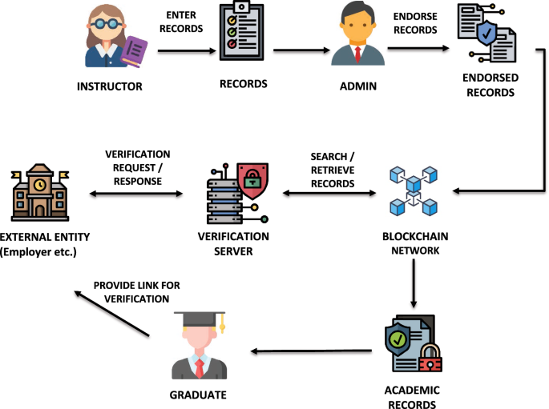

Slide 10



The Frontend development was done using reactjs, npm and tailwindcss to make it faster and reliable in loading and decreases the size of our decentralised web application
Metamask allowed us to interact with the Ethereum blockchain which is mainly used as secure wallet for cryptocurrency.
Goerli testnetwork was used in order to test and deploy our smart contract

Slide 11

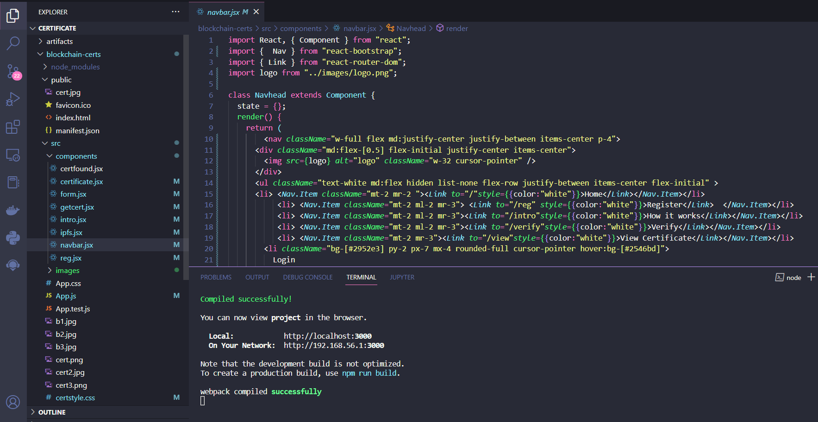
Results and Outputs

Slide 12
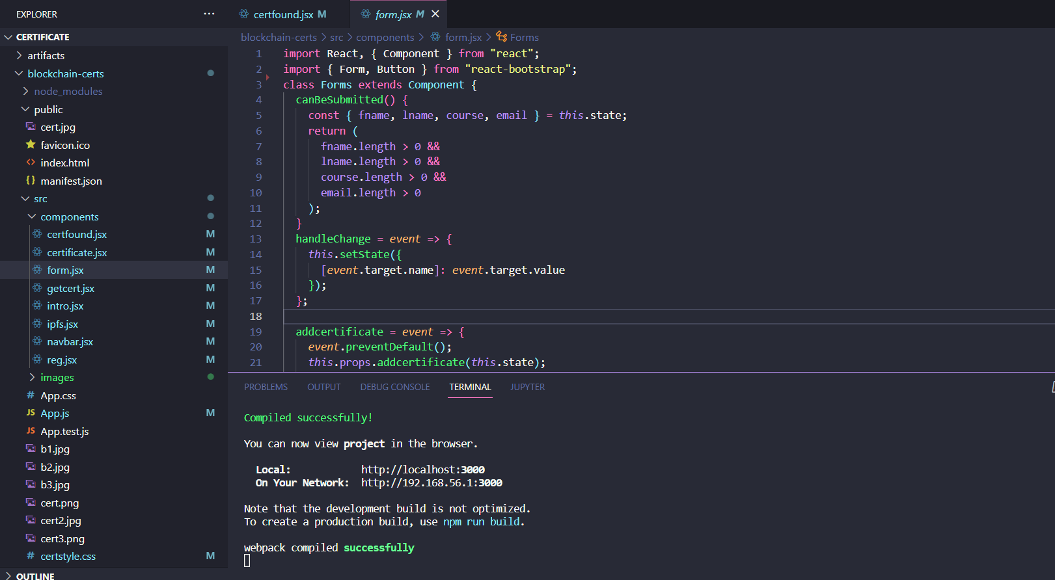
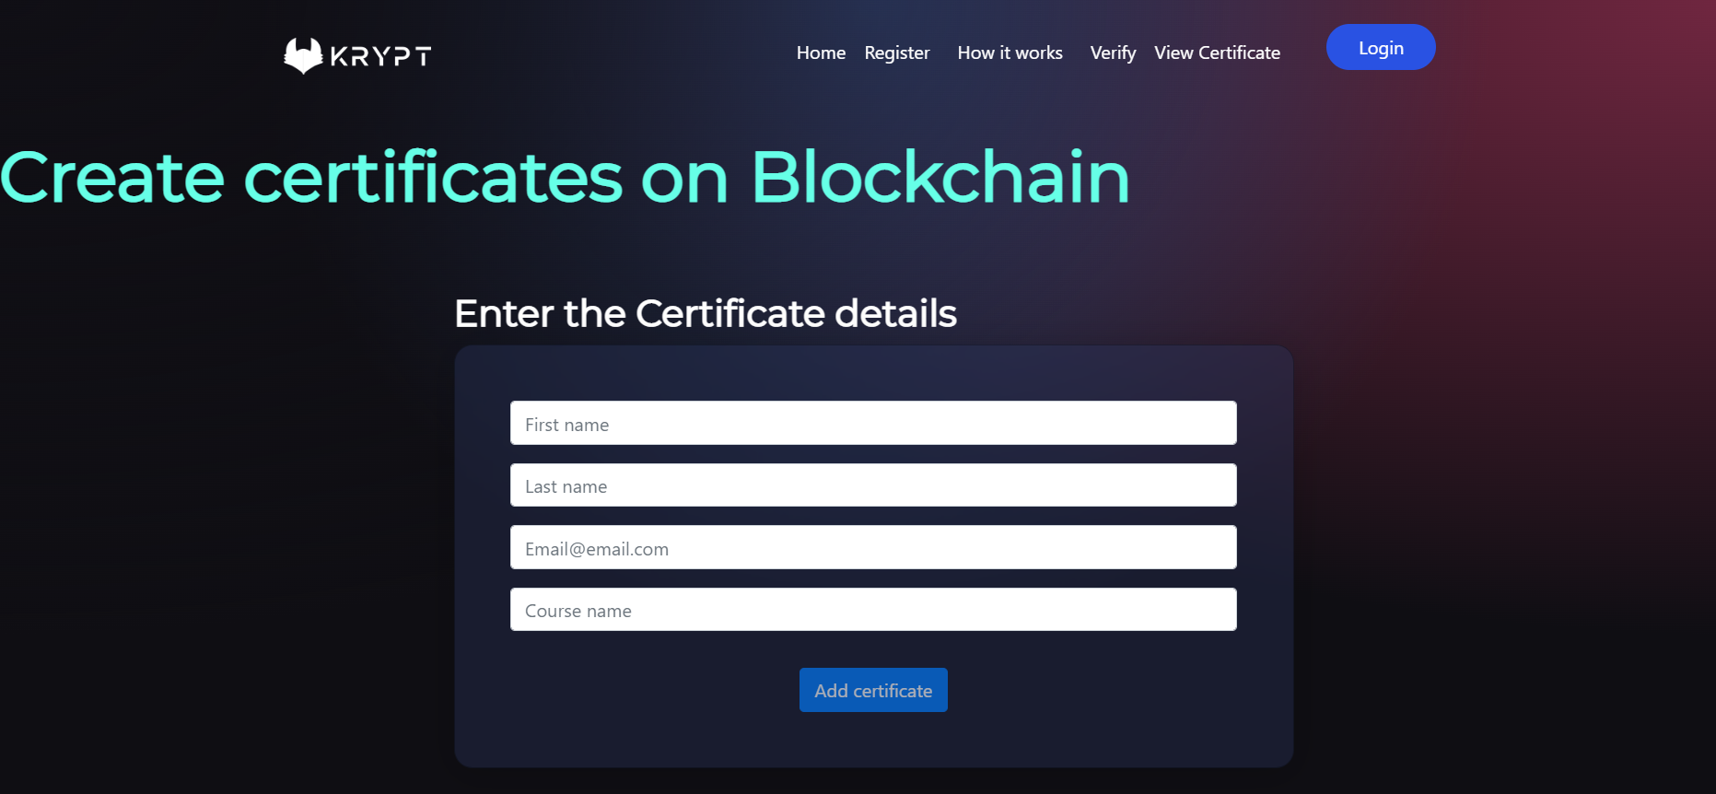

Slide 13
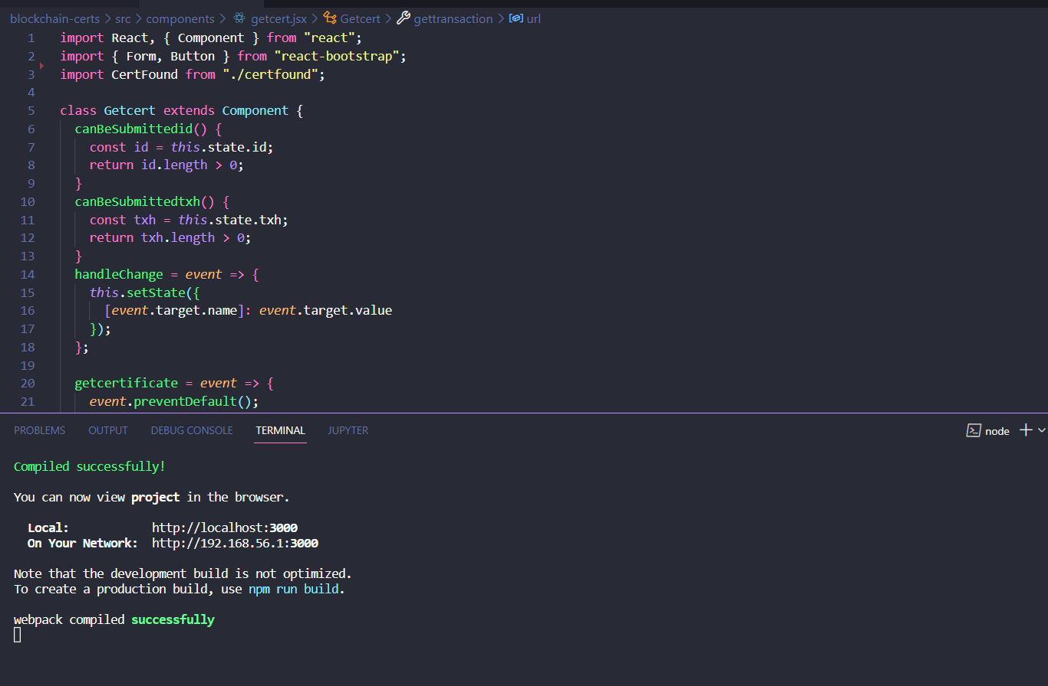
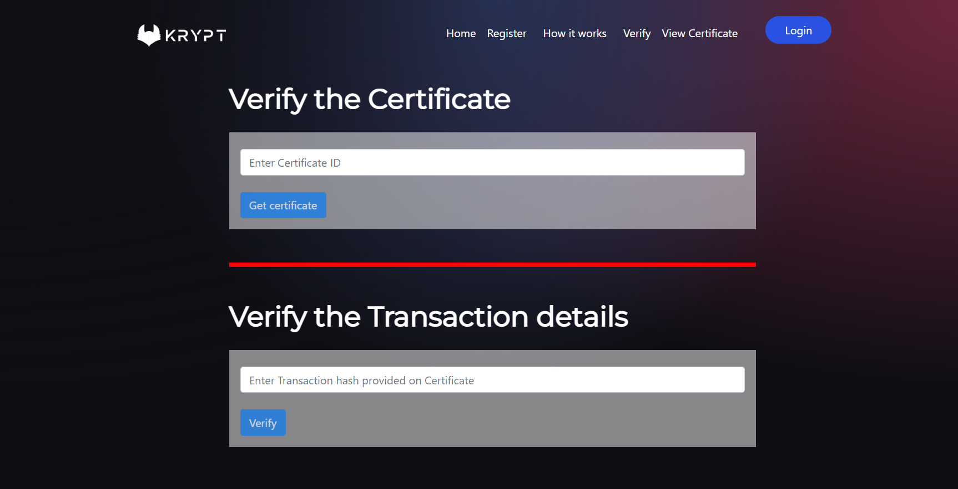

Slide 14
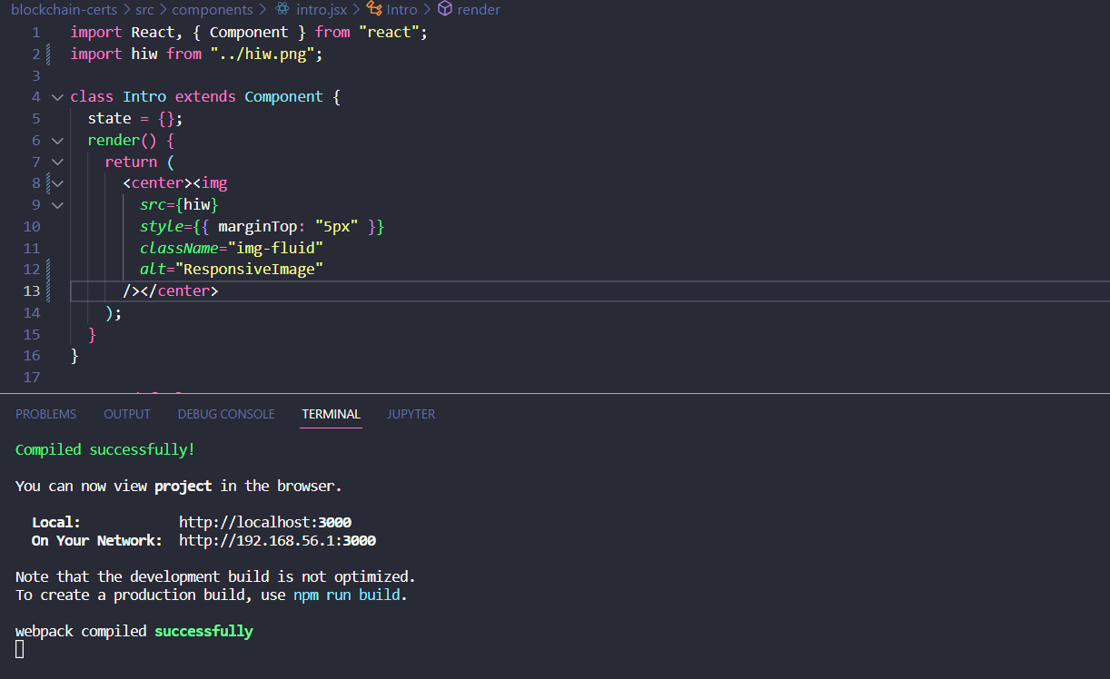
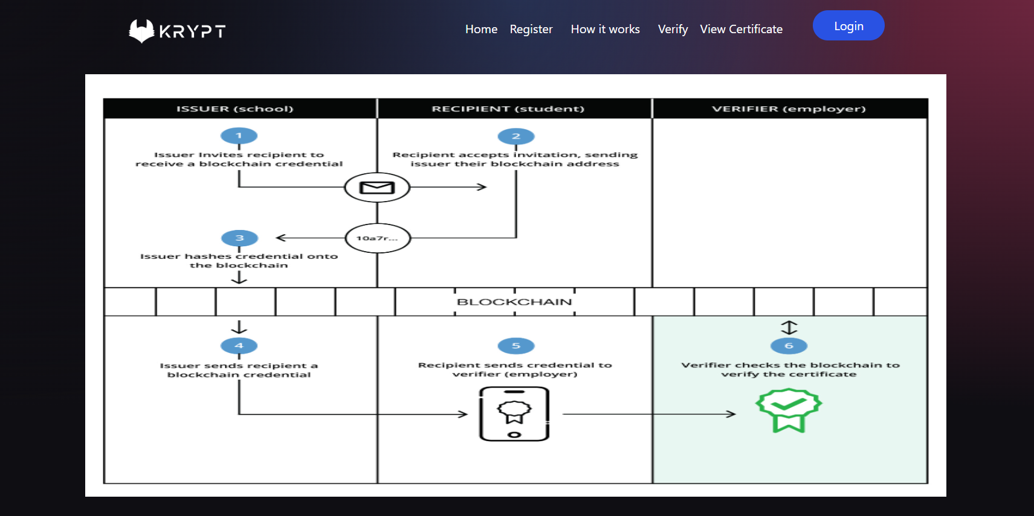

Slide 15
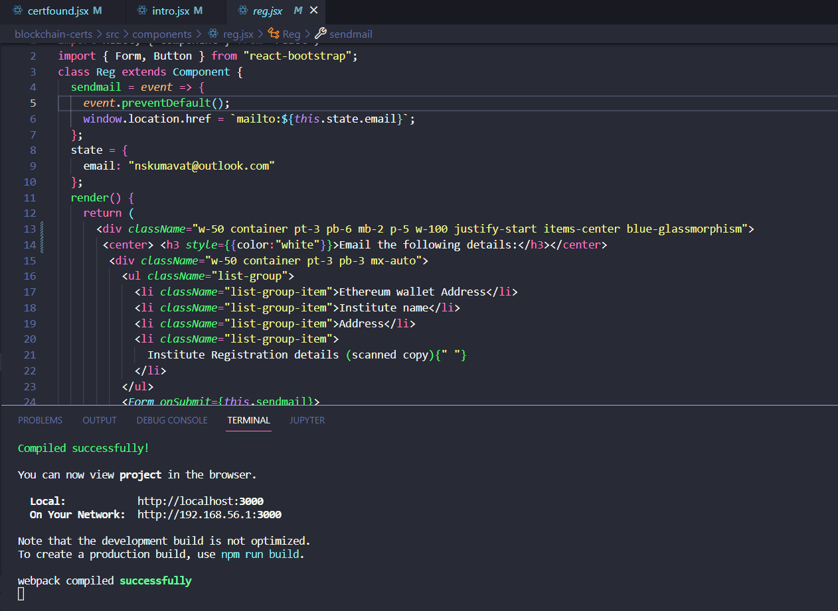
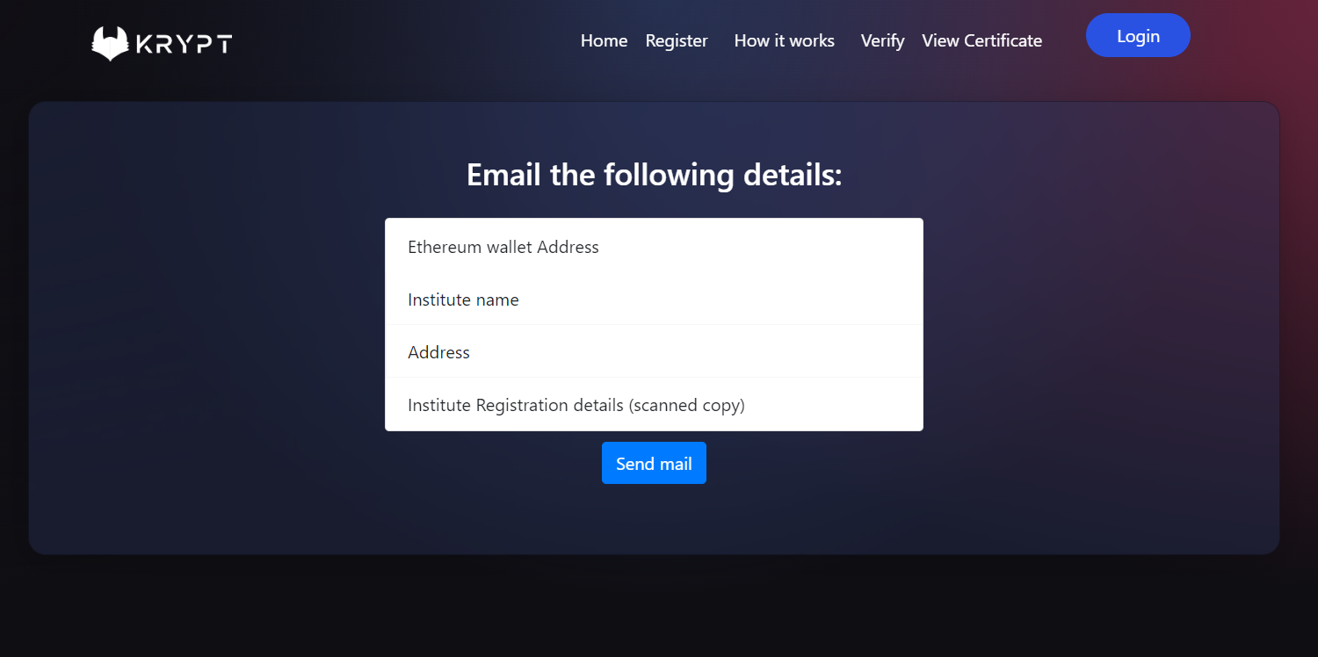

Slide 16
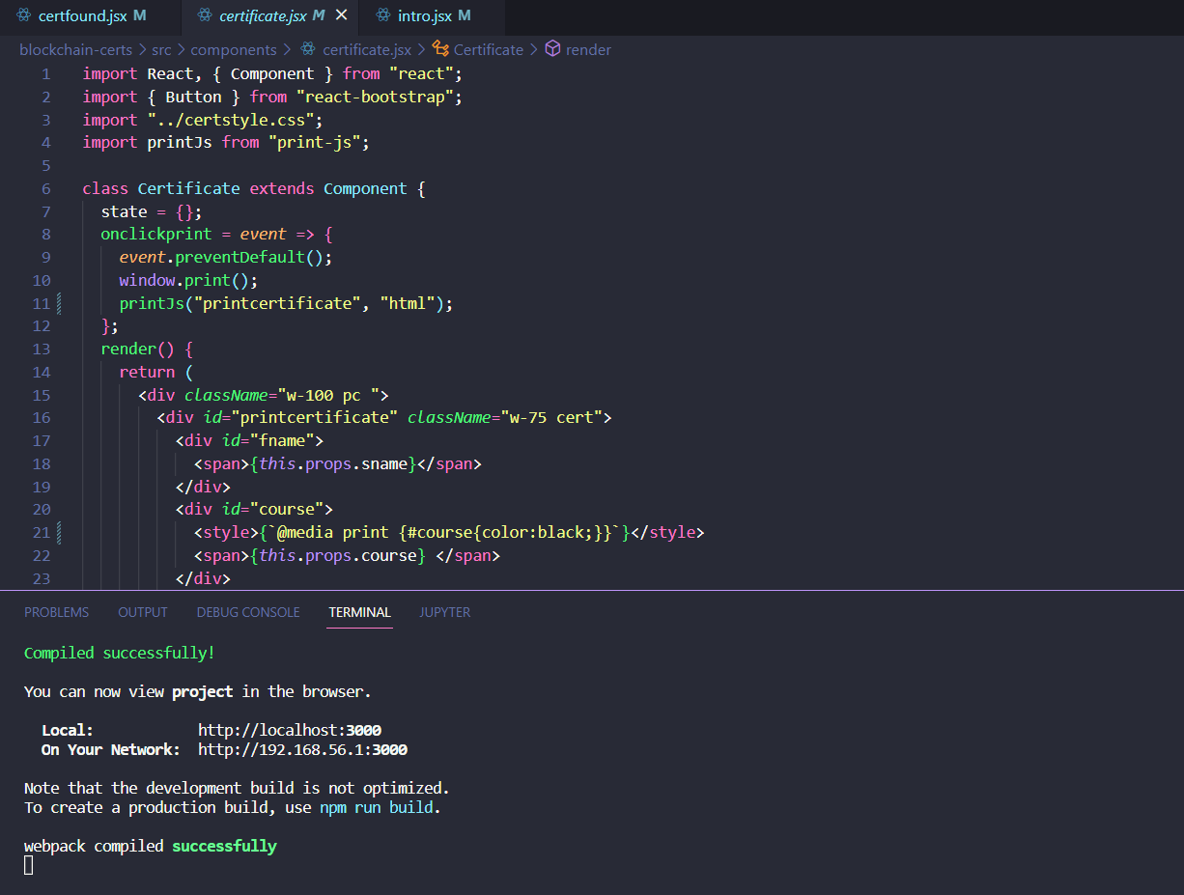
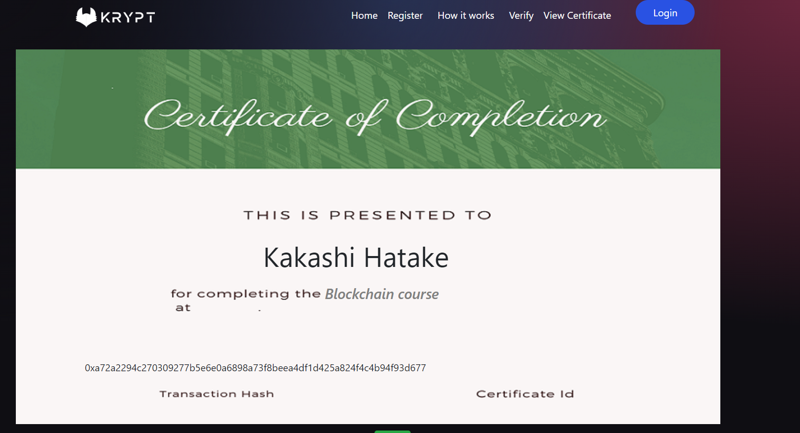

Slide 17
Conclusion
The resulted web application based on the blockchain technology will furthermore corelate with other existing educational application this will solve the problem of the forged certificate, manual authentication of each record and create the process much more efficient by saving weeks of time and paperwork. For analysts, blockchain can possibly be trying to concentrate all the more intently on subjects like identity management, document management, certificate verification, health care, insurance, e-voting, supply chain management, property management etc.

Slide 18
Future Scope
While physical anti-counterfeiting features prevent tampering chances, digital solutions help in intelligence and identifying culprits in the systems as well as facilitating fast and convenient authentication. Many Universities are now using digital track and trace solutions. Prospective employer/ university professionals can check the authenticity of the degree through scanning these QR codes. However, the application of blockchain technology in education domain are more beneficial but still this research topic is in exploratory phase and the proceeding of blockchain standards and regulations is necessary to expand its use in this education domain

Slide 19
References
Professor Kumutha.K and Dr. S. Jayalakshmi “Blockchain Technology and Academic Certificate Authenticity-Review” in 2021 ICOECAIN Bangalore
EURASIP journal on Information Security 2021, Article number 7 by Rama Reddy, T., Prasad Reddy, P.V.G.D., Srinivas, R.
“Blockchain-Based Academic Certificate Verification System—A Review” conference paper by Shivani Pathak, Vimal Gupta, Nitima Malsa, Ankush Ghosh & R. N. Shaw.

